Slide 1
Network scientific analysis about the vulnerability of the Swiss Railway network
Network Science: Final Project
Mathias Lüthi
Nino Scherrer
Peter Giger

Slide 2

Overview
Motivation
Related Work
Swiss Railway Network
Data
Analysis
Conclusion

Slide 3
Motivation

Slide 4
Remember the last time this happened?

Slide 5
Consequences

Slide 6
Fun SBB Facts
Compensation for delays (around 10.- CHF when > 60 minutes)
Compensation for last scheduled connection (SBB organizes/pays accommodation or Taxi)
NO provision for missing flights, concerts, examinations, working hours….
+/- 3 minutes are tolerated
Punctuality of around 90% for a customer to move from A to B
Around 8000 problems per year
4 derailments in 2018
22 accidents in 2018

Slide 7
Related Work

Slide 8
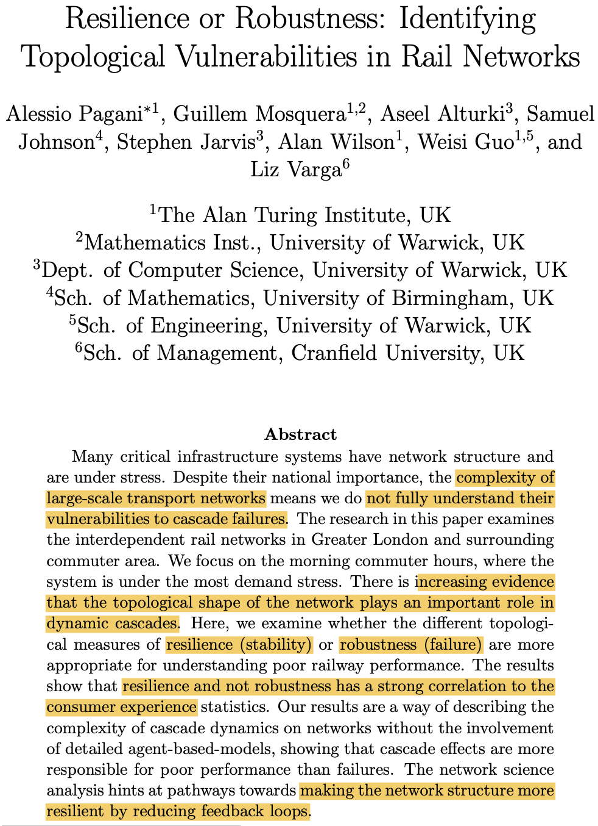
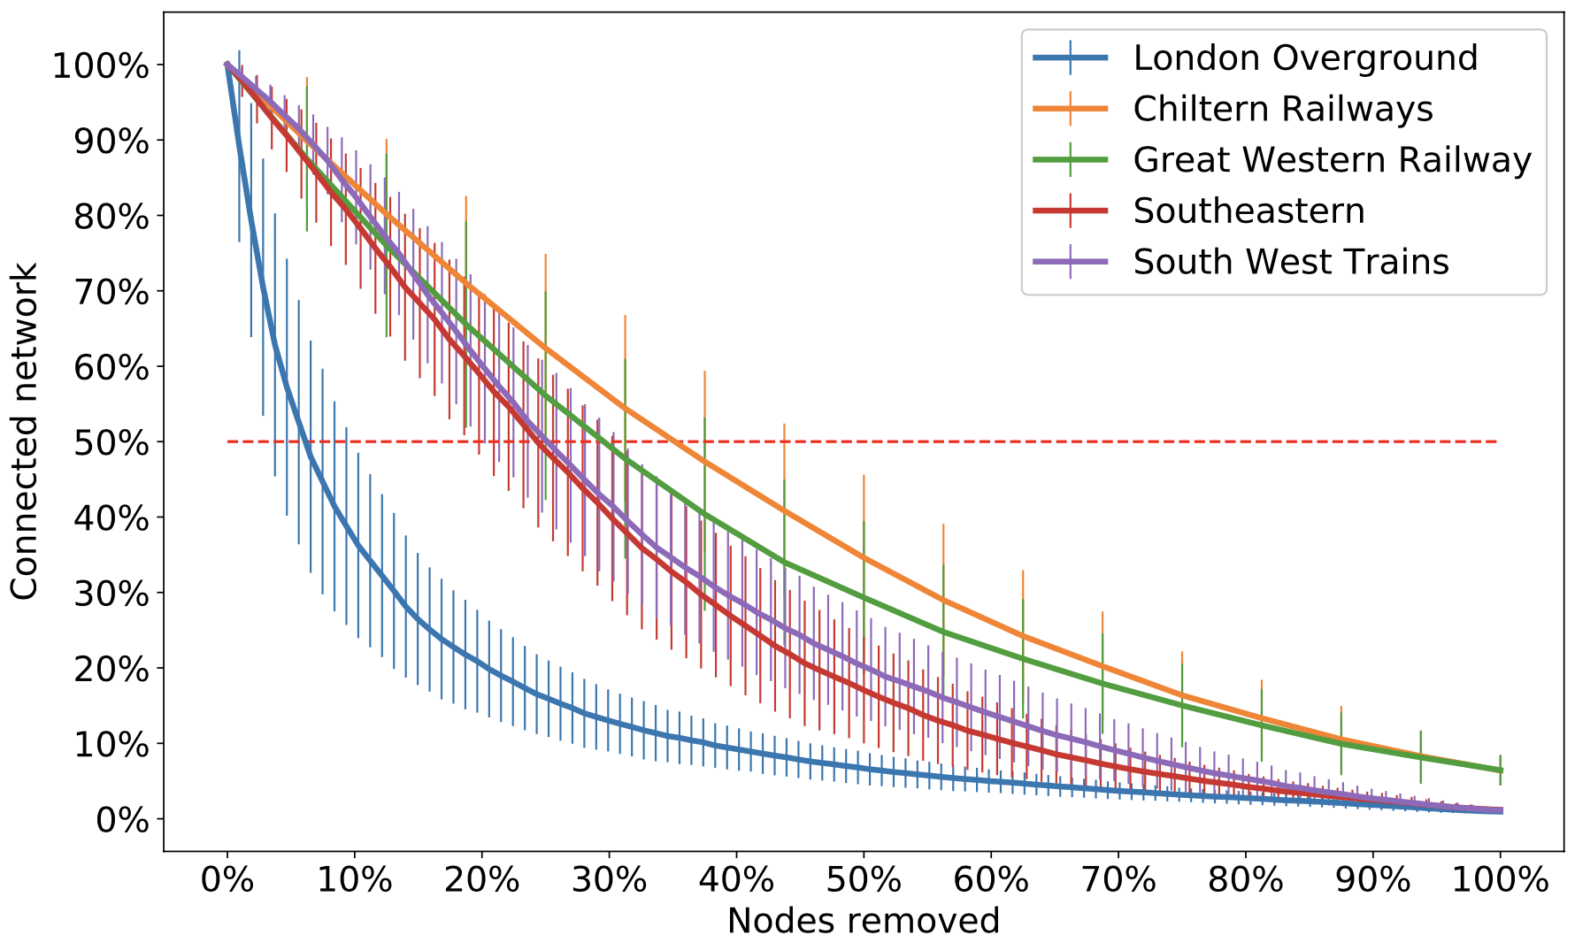
Identifying Topological Vulnerabilities in Rail Networks (2018)
Increasing evidence that the topological shape of the network plays an important role in dynamic cascades
Examine resilience (stability) and robustness (failure) of the UK rail network
Directed weighted graph (edges: passenger flow, nodes: train stations)

Slide 9
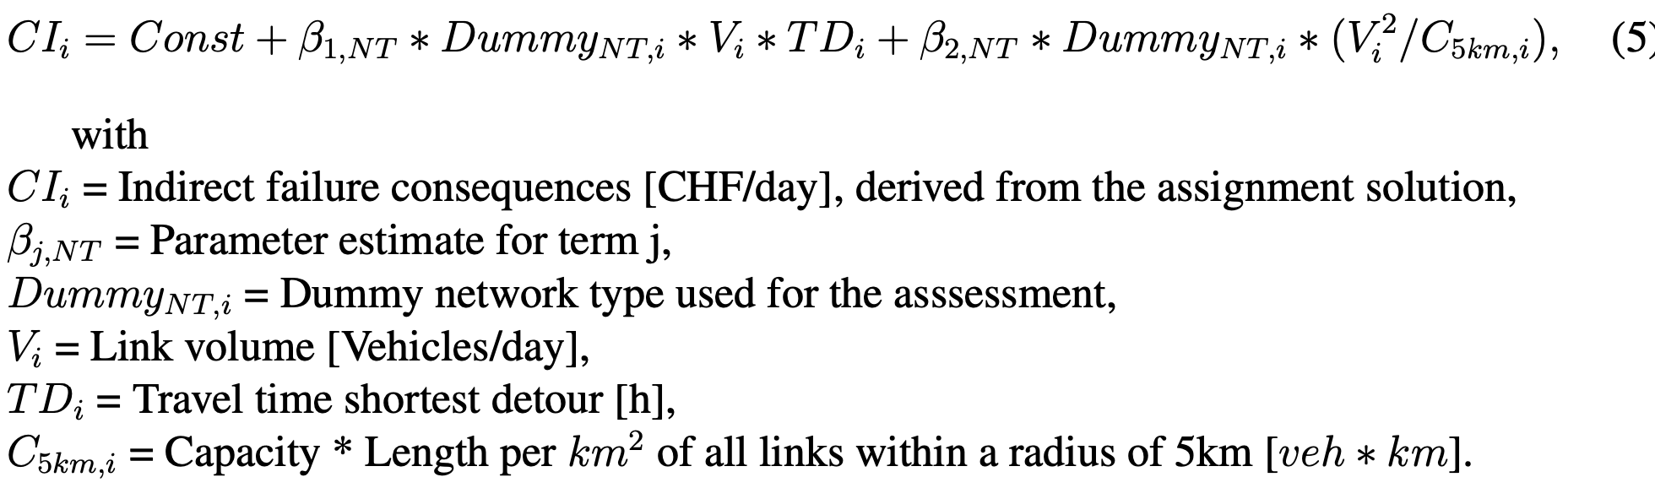
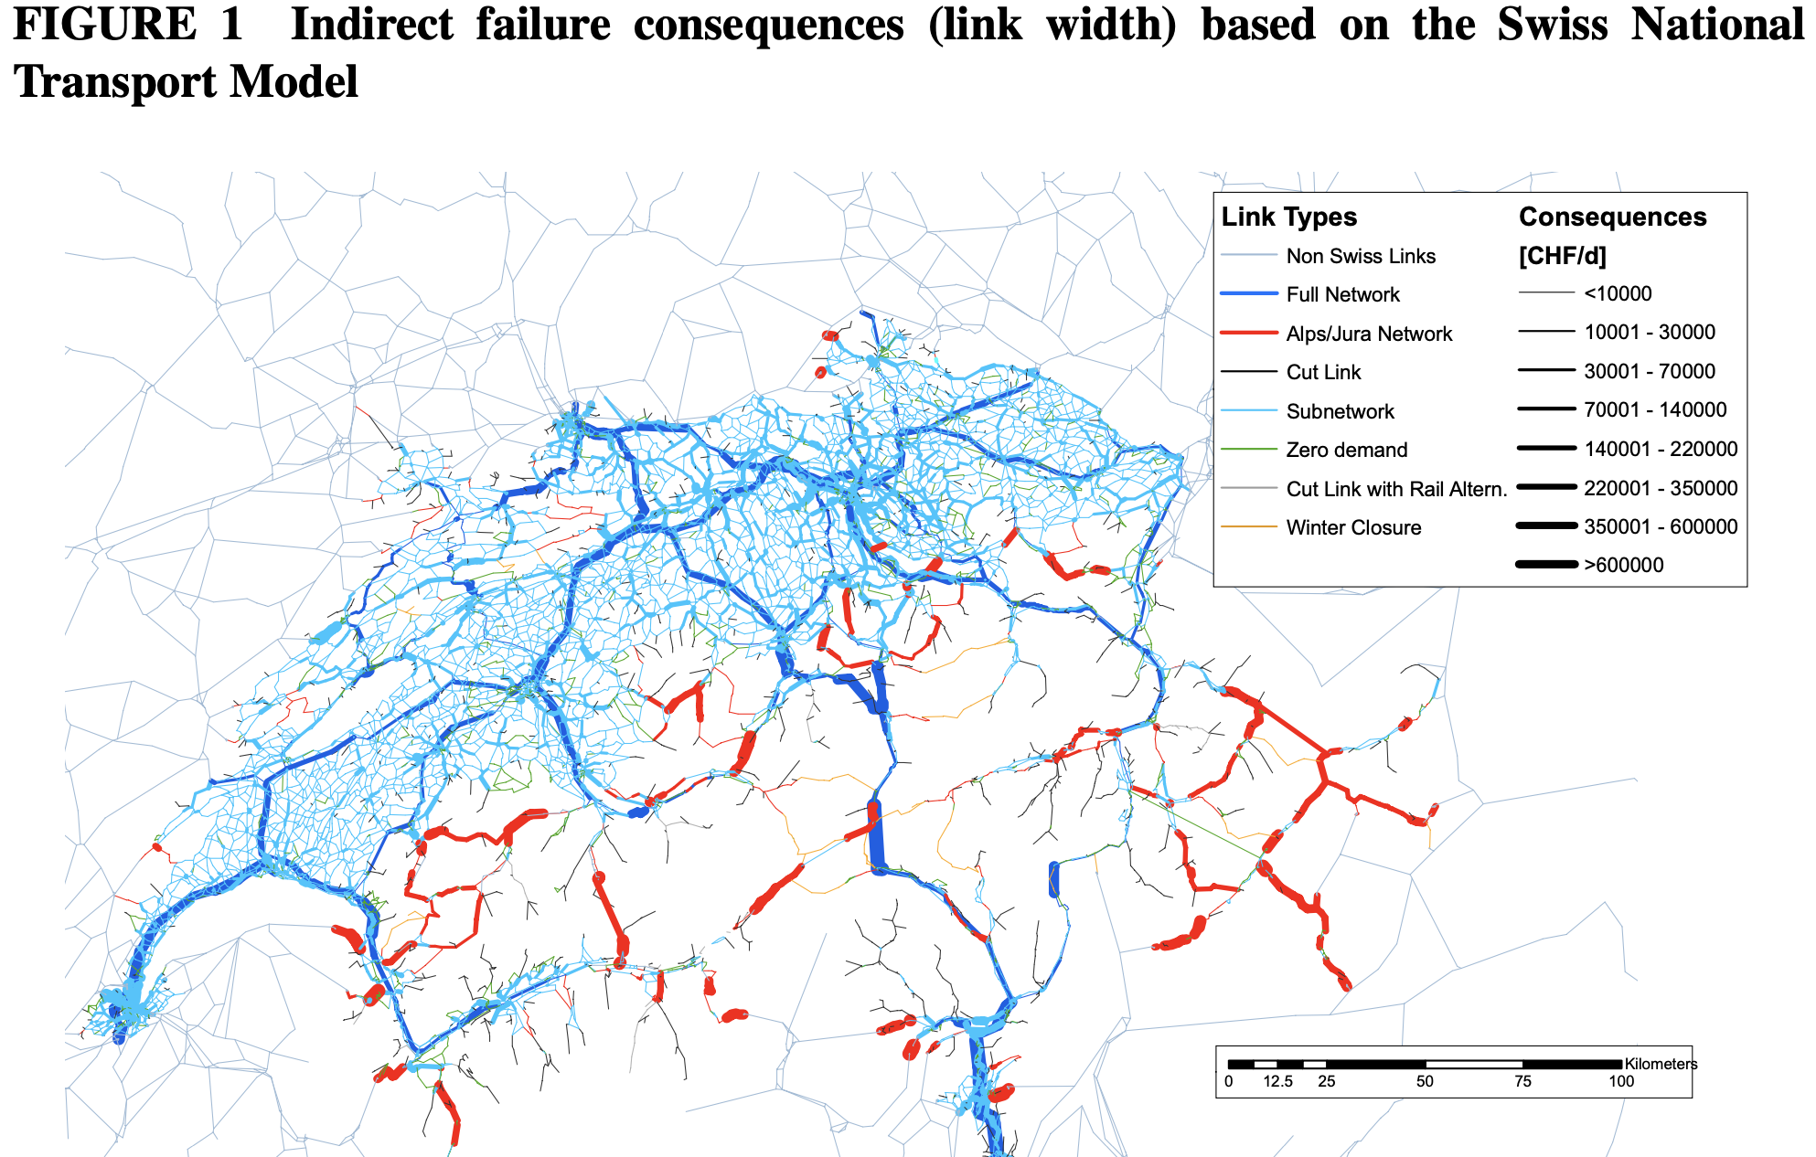
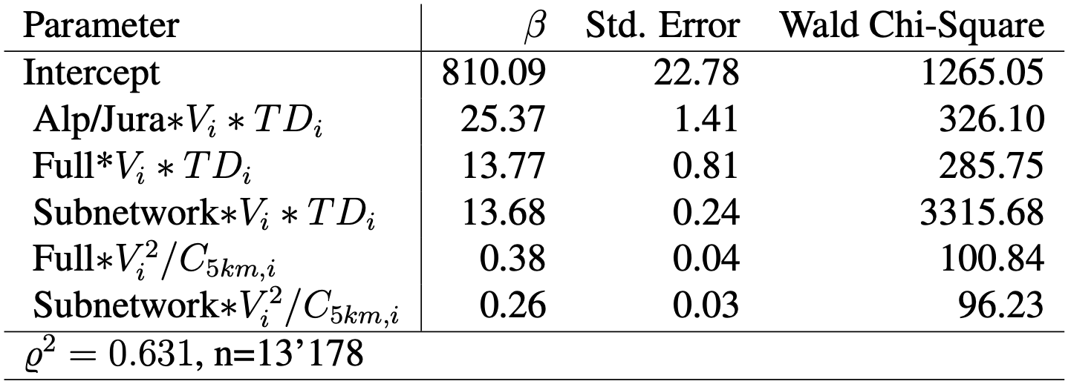
Vulnerability Assessment Methodology for Swiss Road Network (2009)
Generalized Linear Model
Each failure is assumed to be mutually exclusive

Slide 10
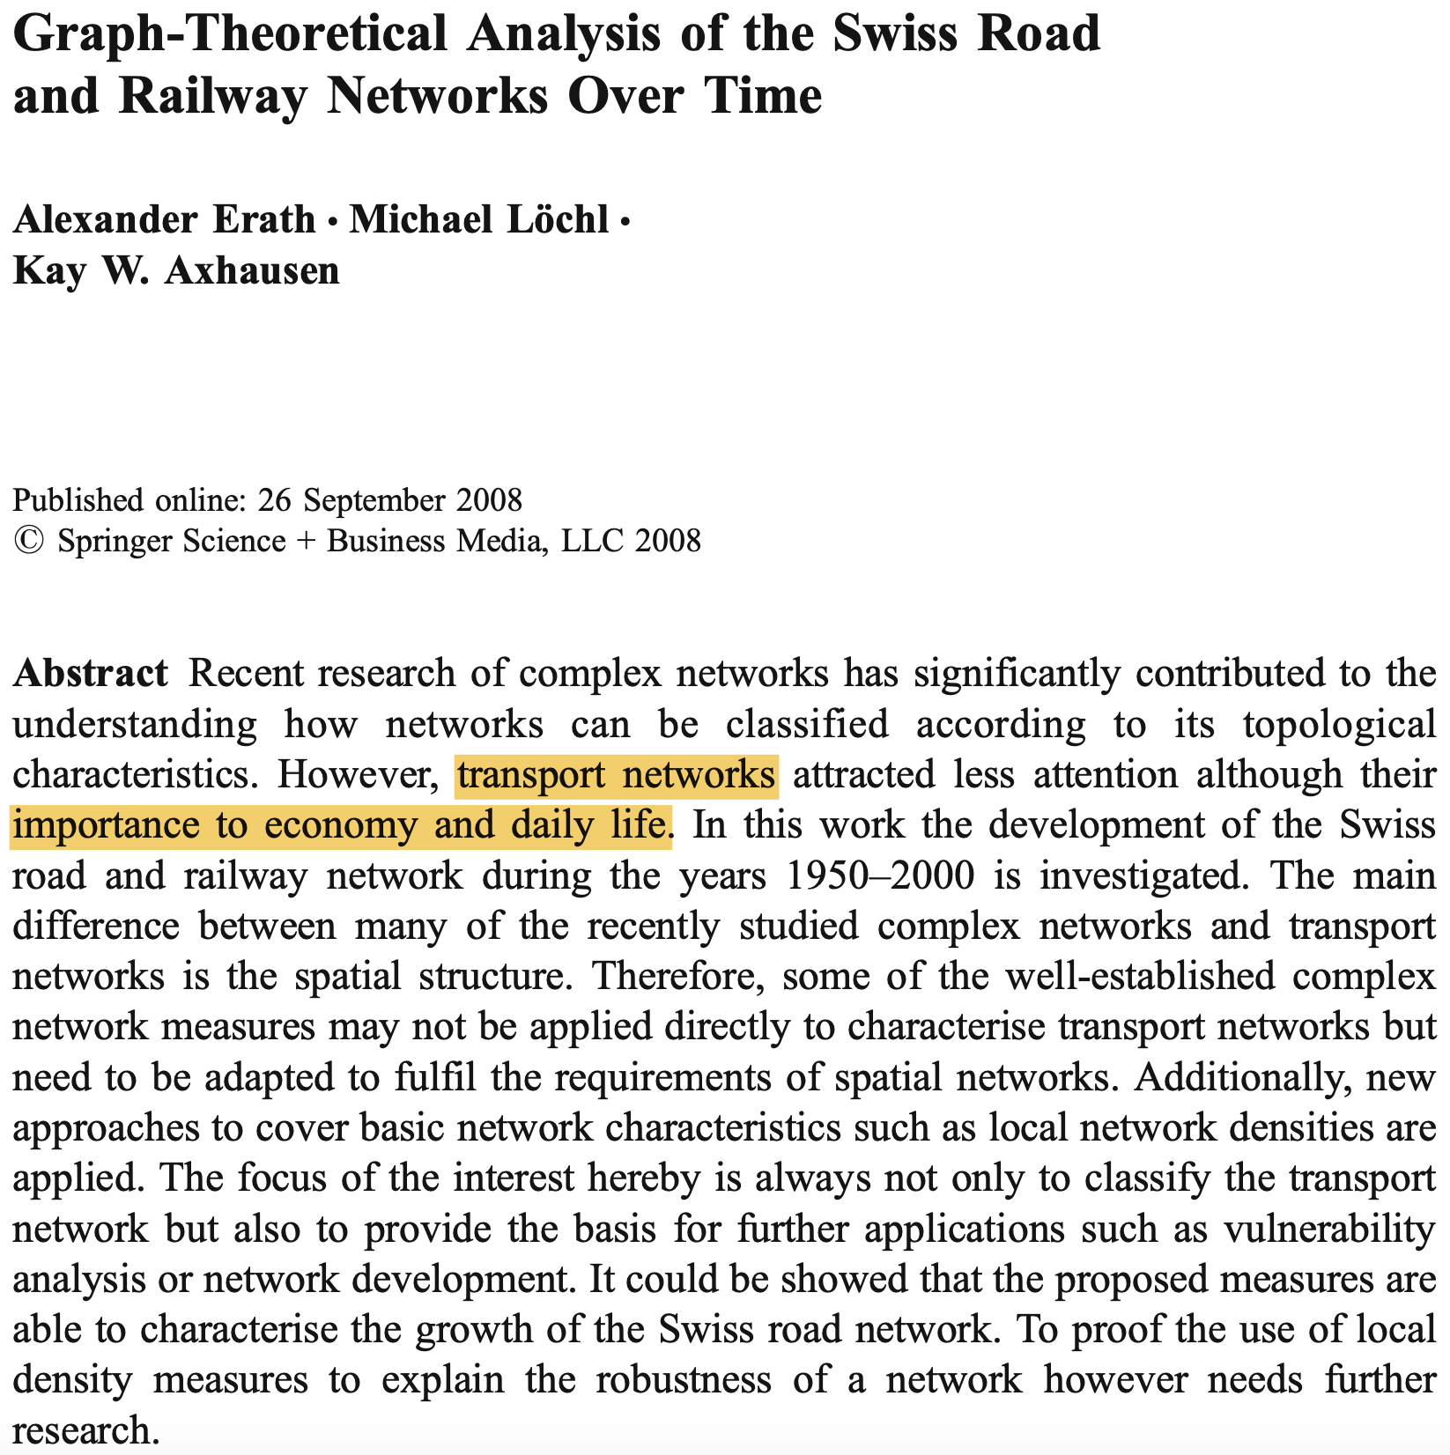
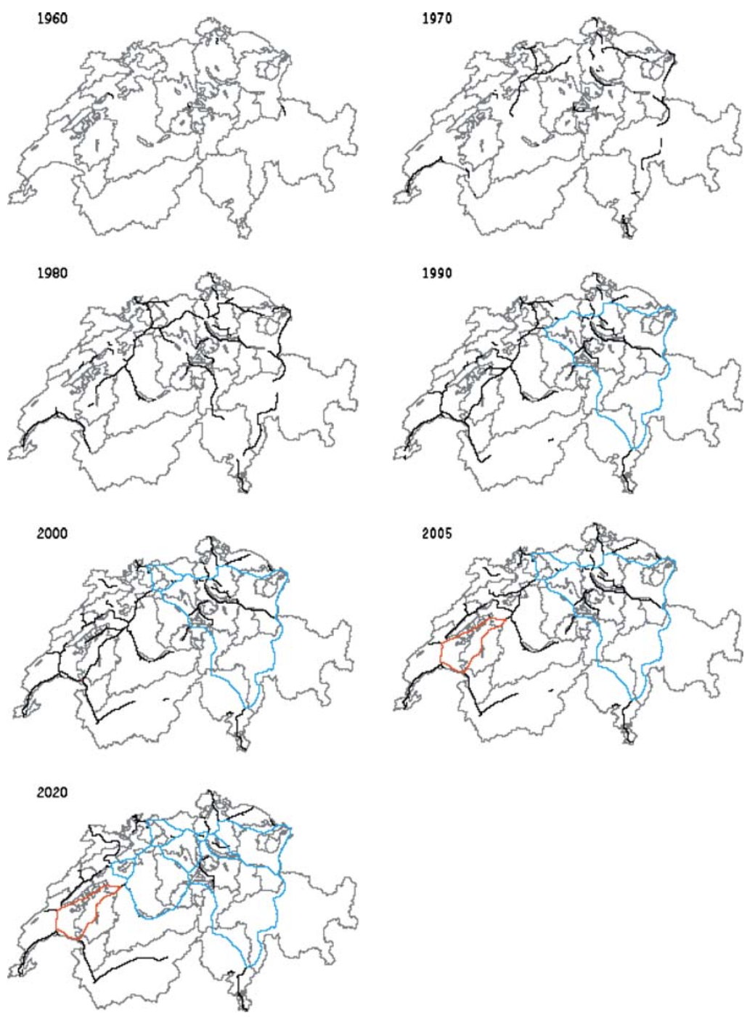
Graph-Theoretical Analysis of the Swiss Road and Railway Networks Over Time (2008)
Degree, closeness, betweenness centrality
Global/Local efficiency
Over time analysis

Slide 11
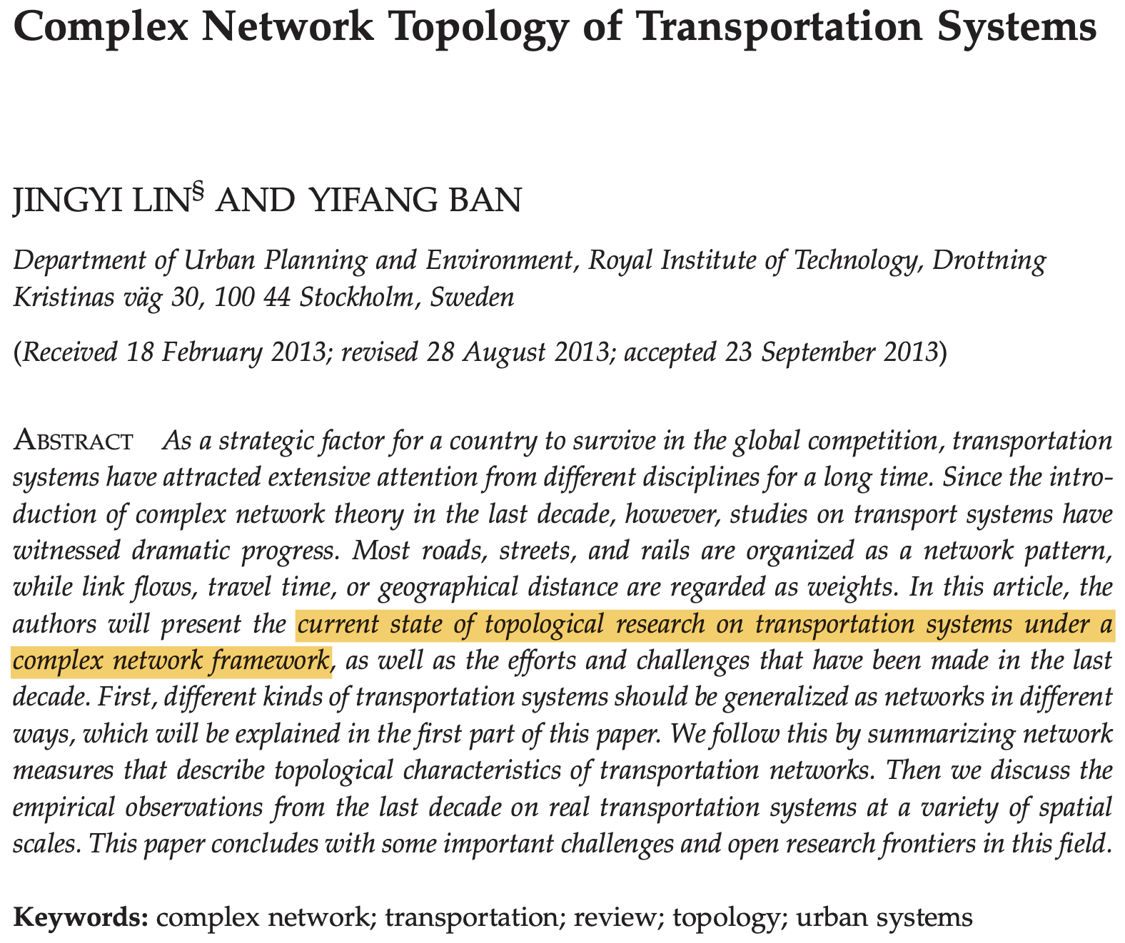
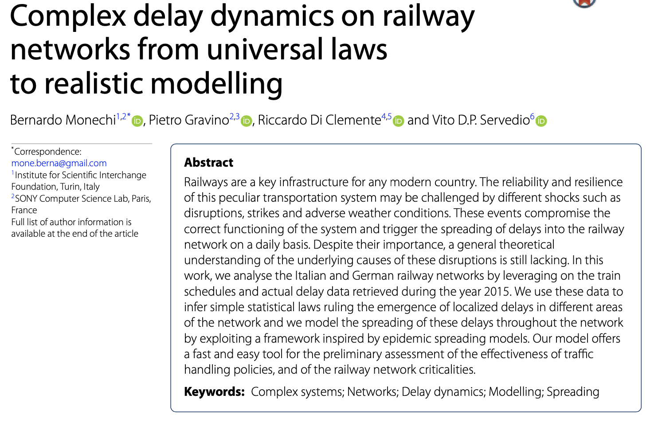
Less related work
L-Space and P-Space
Epidemic Spreading models

Slide 12
Swiss Railway Network

Slide 13
History
Construction and operation began in the 19th century
Mostly carried out by private railways → influences the network structure
In 1901, most railways were nationalized (SBB)
Electrified and upgraded
After WWII, trains lost ground to roads
In 2017, Switzerland was ranked first among European rail systems
Alps covering around 60% of the surface
One of the worlds most dense railway networks!

Slide 14
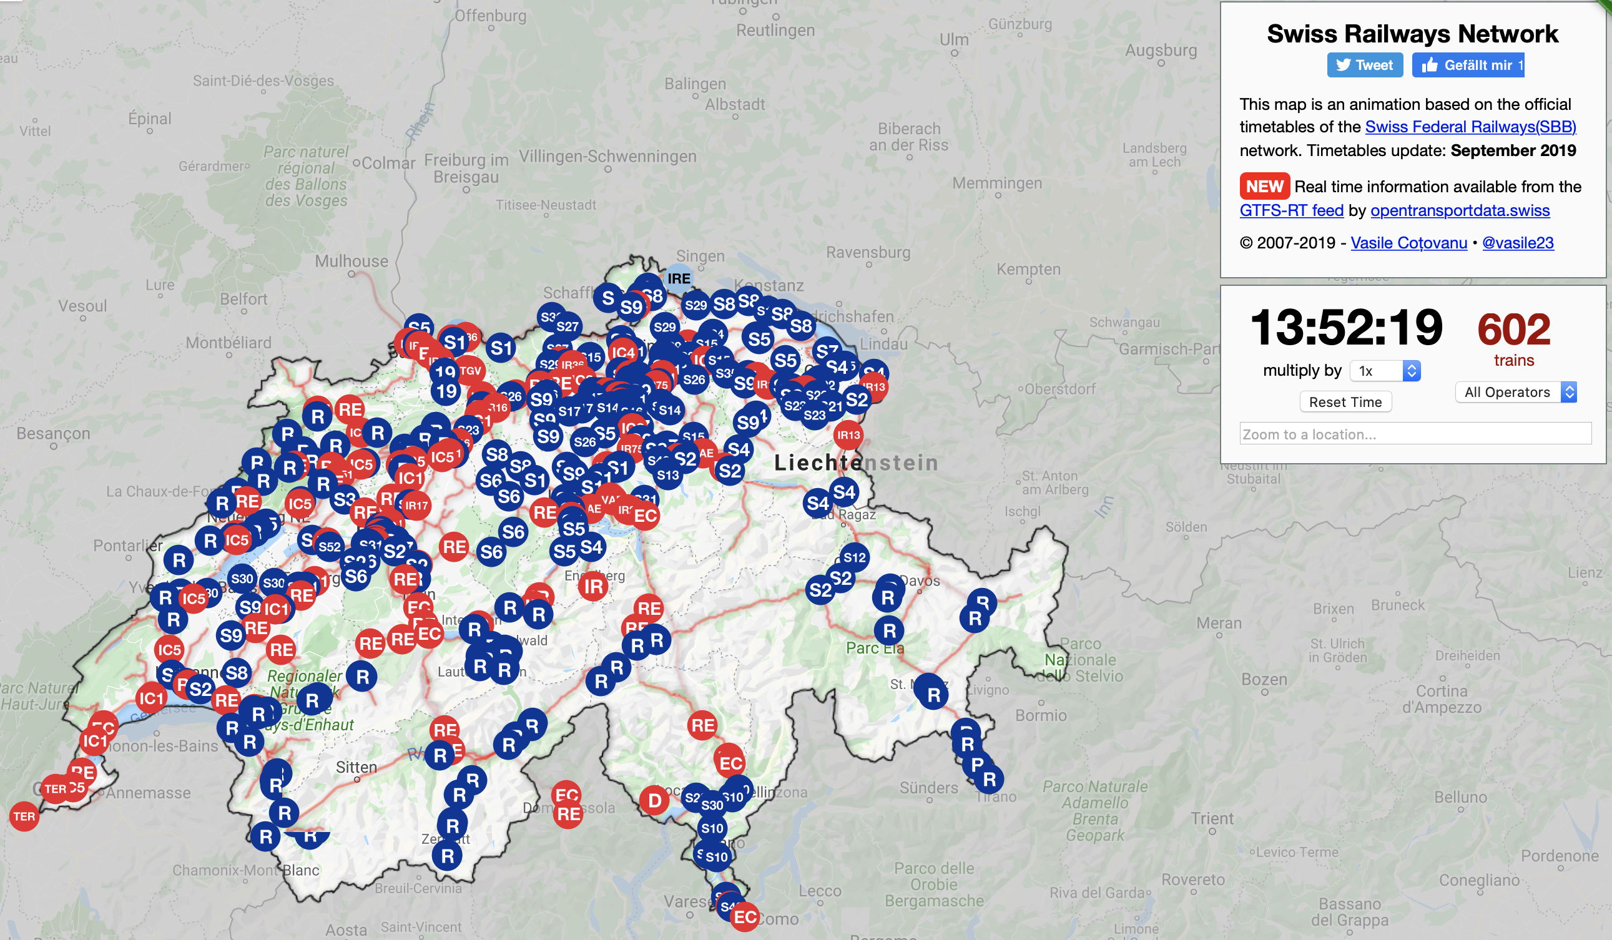
Map
http://maps.vasile.ch/transit-sbb/

Slide 15
Data

Slide 16
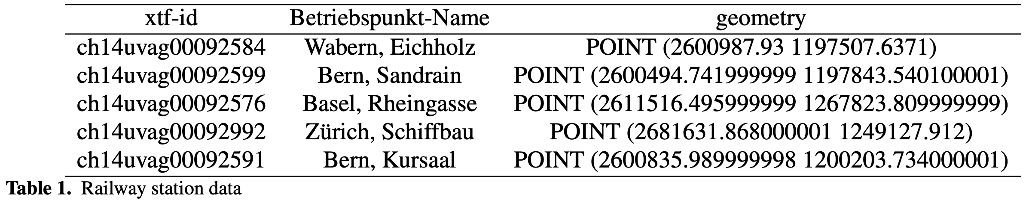
Data Set
Swiss Railway and Tram Network (geo.admin.ch) → 3’190 stations, 3’353 connections

Slide 17
Data Preparation
Problem:
4 nodes without any connections
47 connected components
Biggest one contains 1650 nodes, 53 % of the network
Large stations e.g. ”Interlaken Ost” has “Platform 1-2”, “Platform 3-4” and “Platform 5-8”
Close by stations e.g. “Bern SBB” and “Bern RBS”

Slide 18
Data Preparation
Solution:
Assume everything within walking distance is connected
Merge everything with spatial distance < 300m
47 components → 5 components
Giant component 53% → 99% (3’109/3’139 nodes)

Slide 19
Analysis

Slide 20
Characteristics
Degree Distribution → average k=2.13
Most nodes only have 2 connections
Economically most important cities have more (e.g. Zürich, Bern)
Low clustering coefficient C = 0.016

Slide 21
Random Attack Targeted Attack
Remove 200 nodes for 50% giant component
Remove 500 nodes for 10% giant component
Remove 100 central nodes for 15% giant component

Slide 22
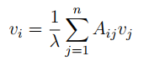
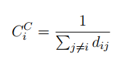
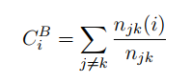
Comparing Targeted Attacks
Targeted attacks on top 100 nodes
Eigenvector Centrality (Zürich, Altstetten)
Closeness Centrality (Olten, Bhf)
Betweenness Centrality (Wanzwil)

Slide 23
Edge Attacks
Rare that a whole station fails
Often certain tracks
Targeted attack on top 20 important edges → 15% giant component

Slide 24
Comparison Random Networks
Erdös-Renyi (ER)
Barabasi-Albert (BA)

Slide 25
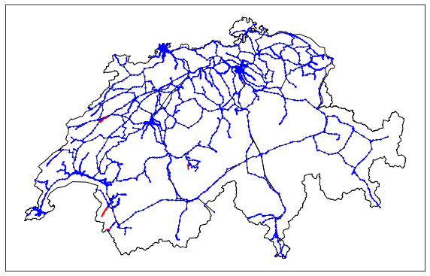
Swiss Railway Network attacked on Degree Centrality

Slide 26
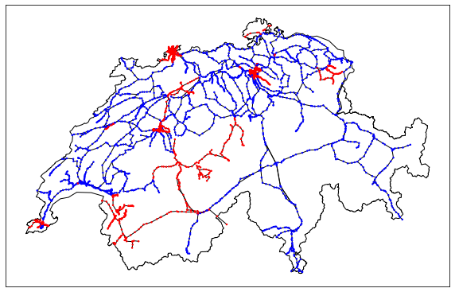
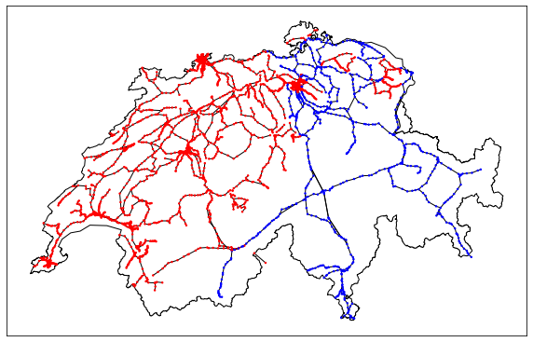
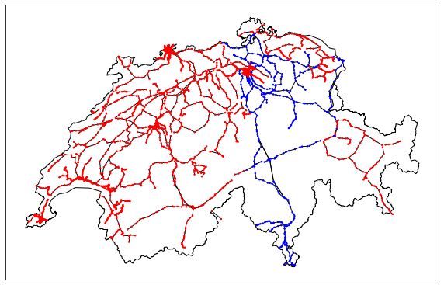
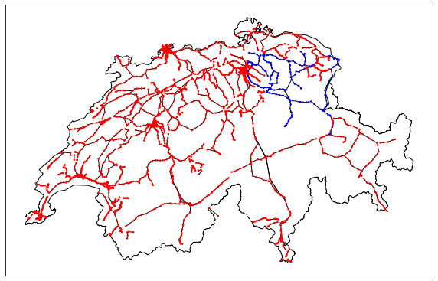
After 50 attacks
(64)
After 100 attacks
(134)
After 150 attacks
(208)
After 250 attacks
(325)

Slide 27
Conclusion

Slide 28
Conclusion
Quite robust against random node attacks (remove 200 nodes for 50% giant component)
At risk for targeted node attacks (remove 100 nodes for 15% giant component)
At risk for targeted edge attacks (remove 20 edges for 15% giant component)
Further research: Include data about track length, number and capacity

Slide 29
Questions?

